Slide 1

BOPRC R Lesson #1: Fundamentals of R
May 13, 2025

Slide 2
Topics
How to set up a project in R
Relative directories
Best practices in R coding
Common questions and errors in R
Real code examples
Accessing buoy and BOPRC data
Visualizing a CTD profile
Visualizing a time series of buoy data
Calculating common limno-metrics (thermocline depth, etc.)

Slide 3
The R Project for Statistical Computing
R is a free software environment for statistical computing and graphics.
Early development in 1991 by statisticians Ross Ihaka and Robert Gentleman at the University of Auckland, New Zealand, oldest release in 1997.
Users have created packages to augment the functions of the R language.
R has local communities worldwide for users to network, share ideas, and learn.
Troubleshooting is ‘easy’ through a worldwide network of likeminded people.

Slide 4
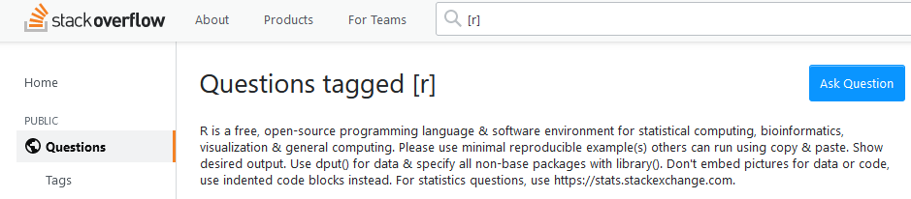
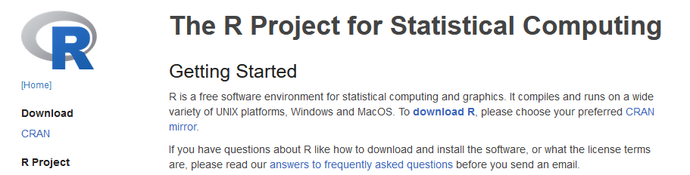

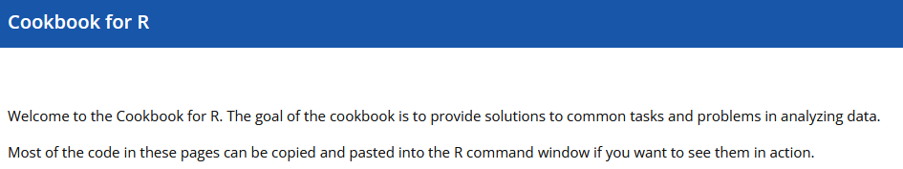
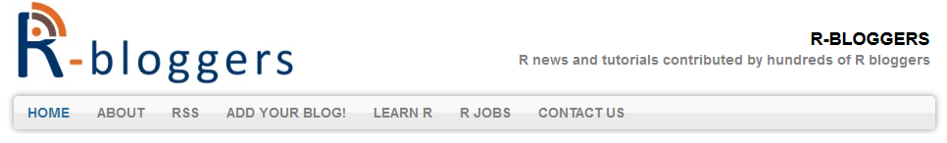
Worldwide support

Slide 5
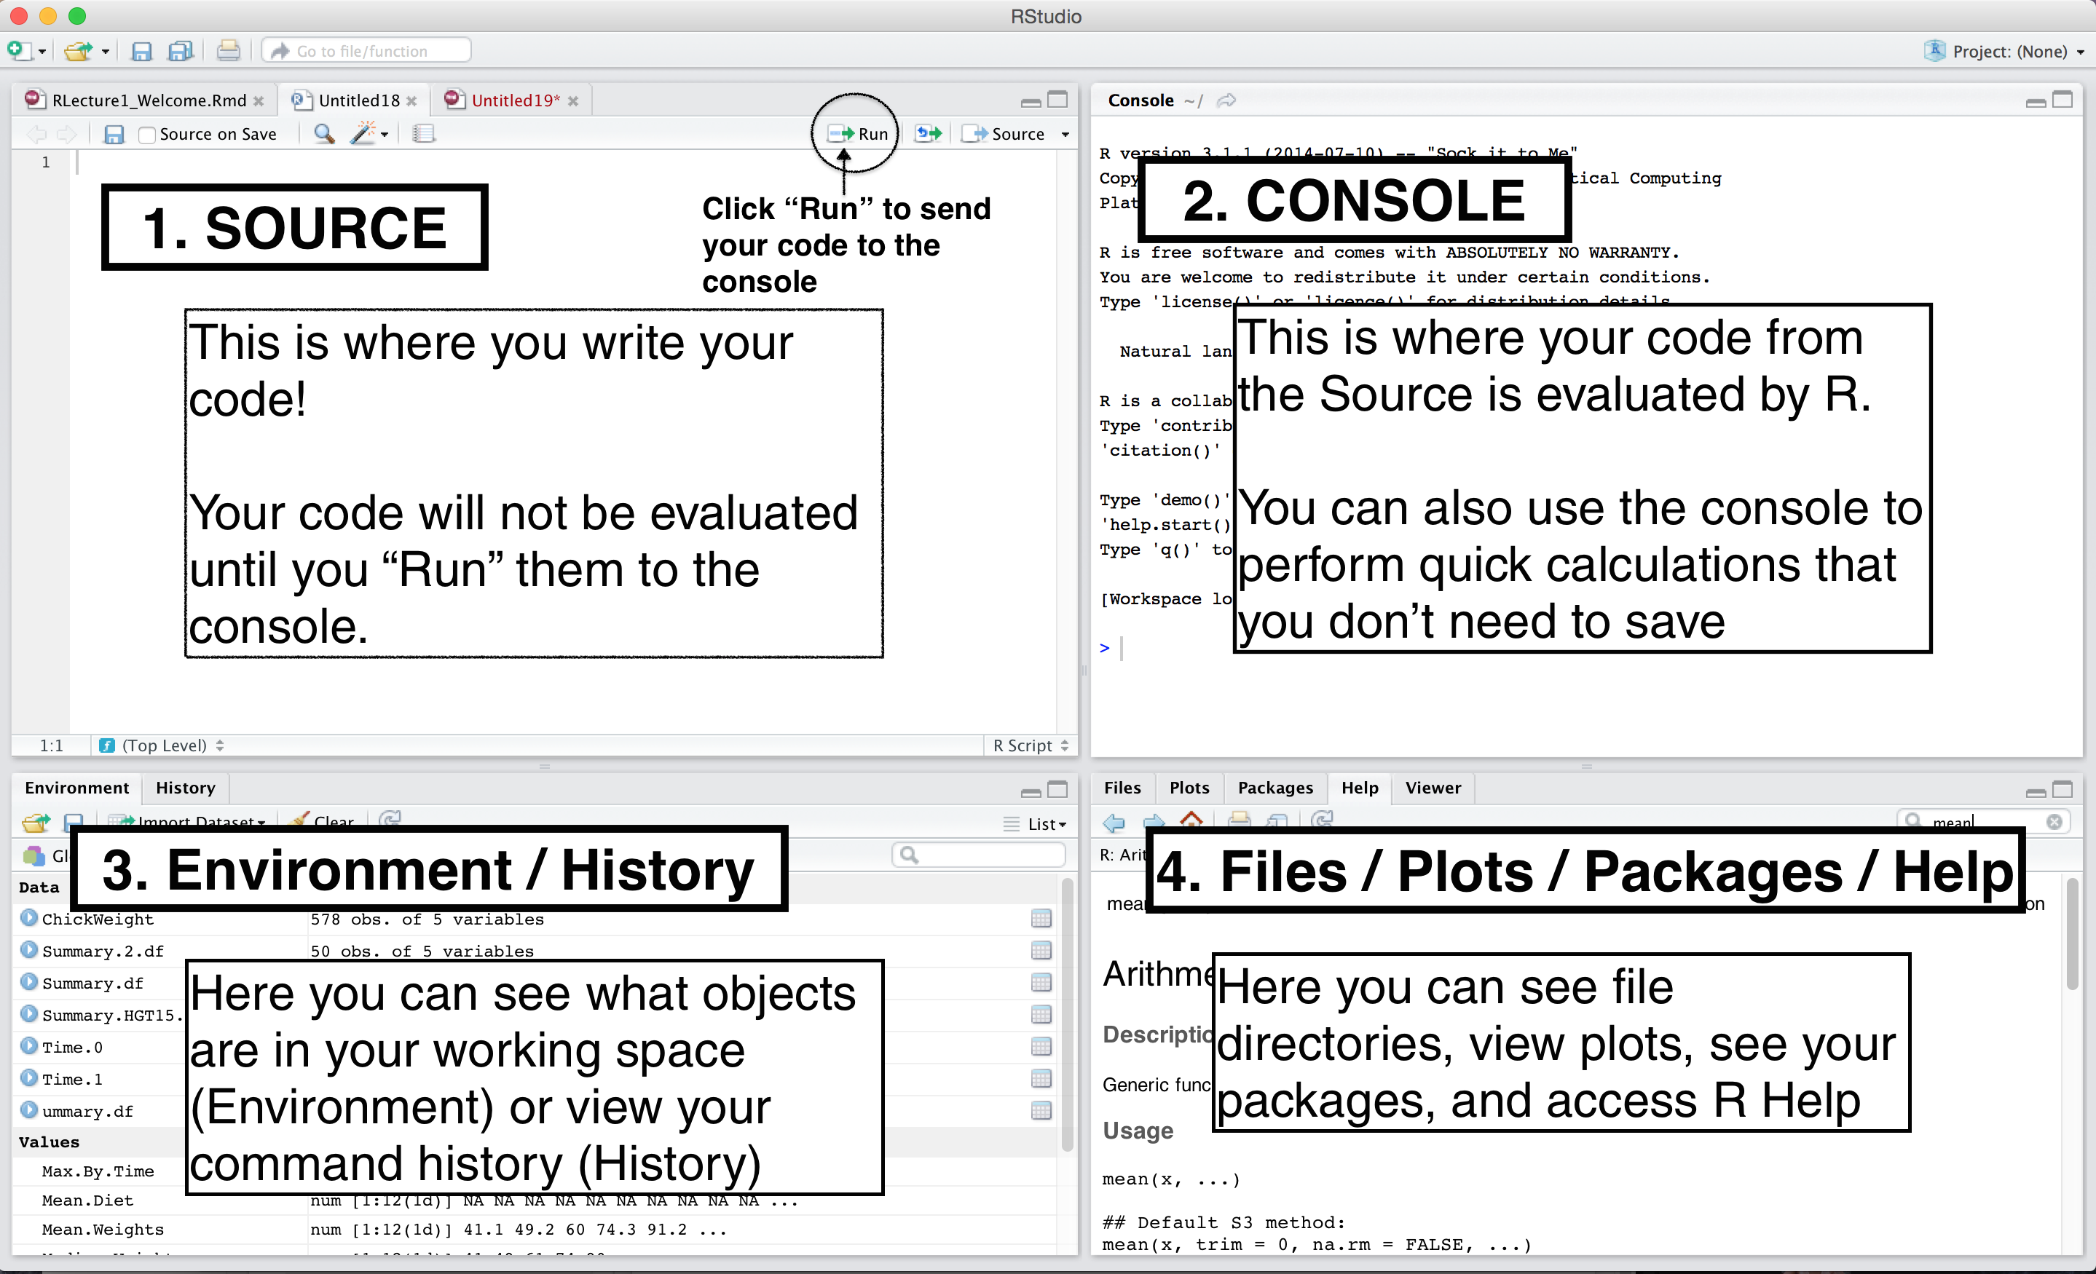
RStudio as a user interface
Can also hit “Ctrl+Enter”

Slide 6
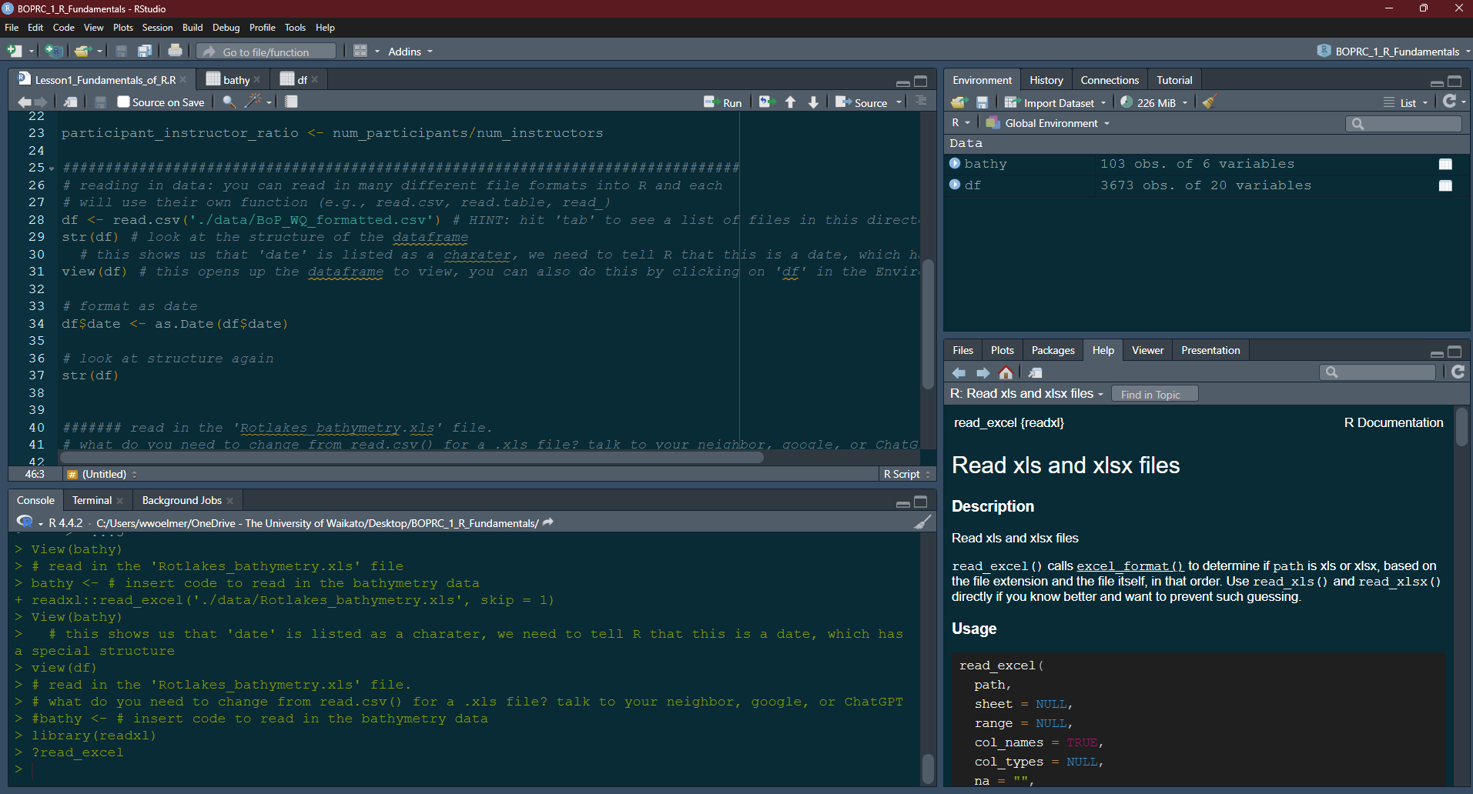
1. Source code
3. Environment
4. Files/Plots/Packages/Help documentation
2. Console

Slide 7
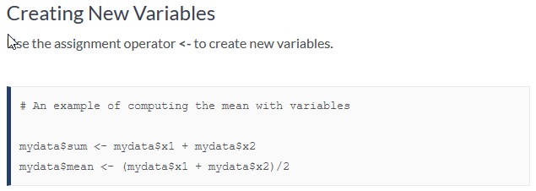
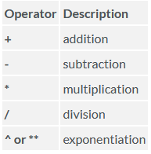
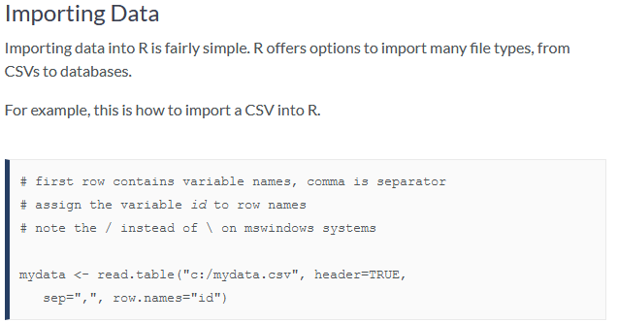
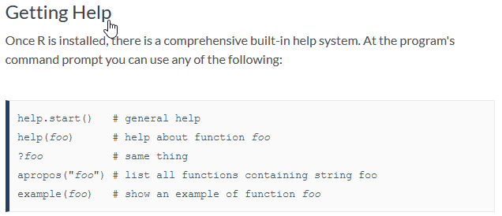
R code basics
Operators

Slide 8

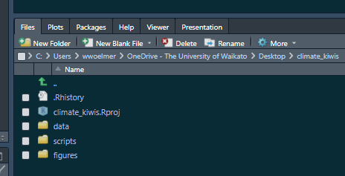



Project-oriented Workflows
Enables repeatability (for yourself)
Enables reproducibility (for someone else)

Slide 9
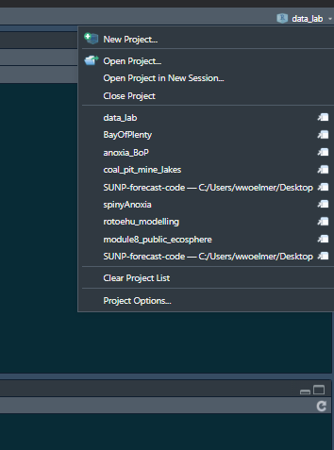
Setting up a “Project” in R
Step 1: Open RStudio
Step 2: Select “New Project” in upper right in Rstudio

Slide 10
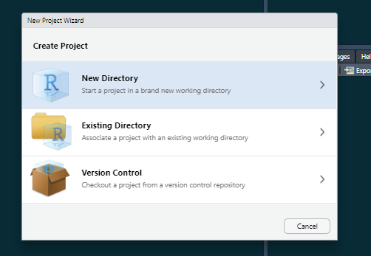
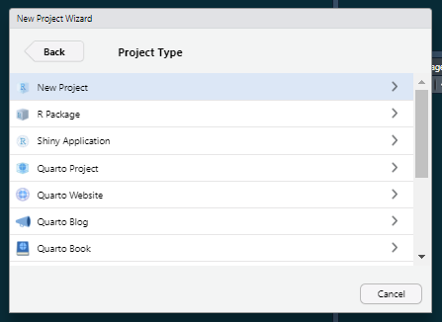
Setting up a “Project” in R
Step 1: Open RStudio
Step 2: Select “New Project” in upper right in Rstudio
Step 3: Select “New Directory” -> “New Project”

Slide 11
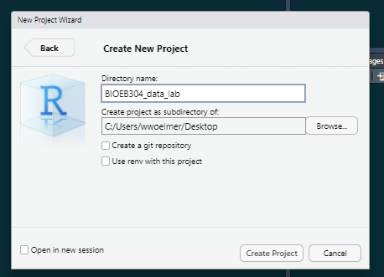
Setting up a “Project” in R
Step 1: Open RStudio
Step 2: Select “New Project” in upper right in Rstudio
Step 3: Select “New Directory” -> “New Project”
Step 4: Name your directory something informative (e.g., BIOEB304_data_lab)

Slide 12
Setting up a “Project” in R
Step 1: Open RStudio
Step 2: Select “New Project” in upper right in Rstudio
Step 3: Select “New Directory” -> “New Project”
Step 4: Name your directory something informative (e.g., BIOEB304_data_lab)
Step 5: Unzip your folder into this location (“Extract all” into the location of your R project)
Step 6: Open the R script

Slide 13
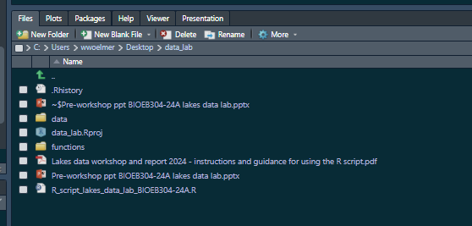
File structure in R should look like this

Slide 14
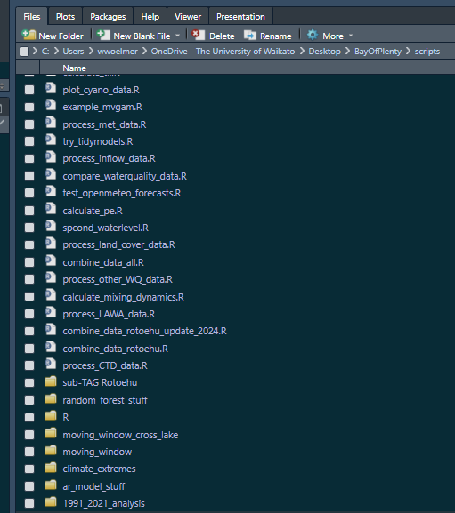
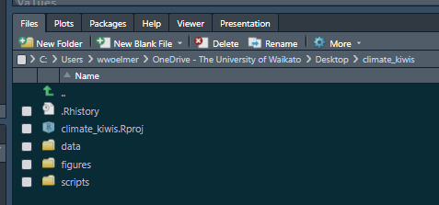
How to use projects
Ideally, these are truly “project”-specific
A set of analyses towards a common goal, typically a manuscript

Slide 15
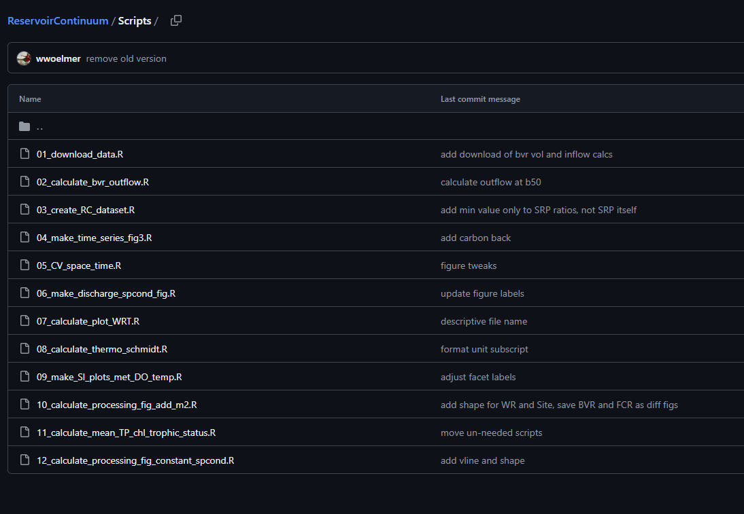
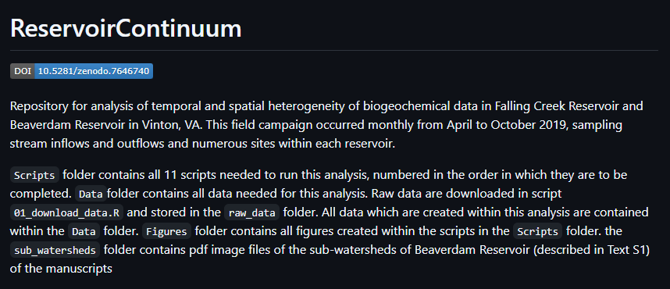
Manuscript within a project
https://github.com/wwoelmer/ReservoirContinuum

Slide 16
Best practices in R
Use projects
Use relative directories
Organize your files
Start with an empty environment, don’t save your workspace
Re-run/test your code every time you open R
You should be able to close R, re-open R, and get back to where you were before
Double-check your output—R will usually give you something (exactly what you asked for), but did you tell it the right thing?
Use ChatGPT, but take it with a grain of salt…

Slide 17
Naming things in R
 | GOOD | BAD (less good…)
Use intuitive, descriptive names | buoy <- read.csv(‘./data/buoy_data.csv’) ctd <- read.csv(‘./data/ctd_data.csv’) | df <- read.csv(‘./data/buoy_data.csv’) df2 <- read.csv(‘./data/ctd_data.csv’)
Don’t use spaces or special characters | ctd_data <- read.csv(‘./data/ctd_data.csv’) | ctd data <- read.csv(‘./data/ctd_data.csv’)
Keep it simple | ctd <- read.csv(‘./data/ctd_data.csv’) | ctd_2019_Rotoehu_bop_temp_do_chl_all_depths_df2 <- read.csv(‘./data/ctd_data.csv’)
Don’t name something the same as a function | thermo_depth <- thermo.depth(data$temp, data$depth) | thermo.depth <- thermo.depth(data$temp, data$depth)
What happens if we run thermo.depth without assigning anything to it?

Slide 18
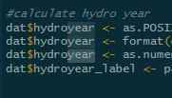
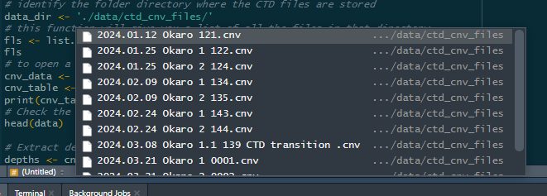
Tips and tricks…
Symbol | Shortcut | Description
%>% | Ctrl + Shift + M | “pipe” operator, reads: whereby
<- | Ctrl + - | Assigning operator
 | Ctrl + Shift + F | Search through all your scripts
 | Alt + Shit + select | Select multiple lines of code
 | Hit “tab” when typing a directory ‘./data/’ + Tab | Will show you a list of items in the directory to choose from

Slide 19
When to put (or keep) things in your script vs in the console
Script = things you want to rerun next time you open Rstudio
Console = things you just need to check for now and don’t need to reproduce later

Slide 20
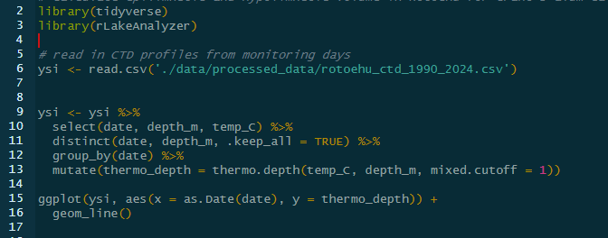
When to put (or keep) things in your script vs in the console
Script = things you want to rerun next time you open Rstudio

Slide 21
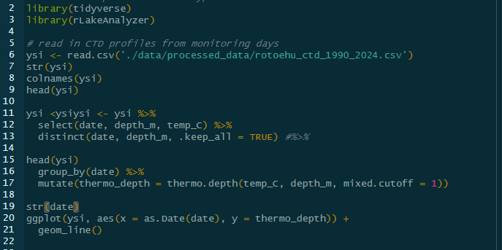
When to put (or keep) things in your script vs in the console
Script = things you want to rerun next time you open Rstudio
But coding is an iterative process, so when you’re coding it might look more like this

Slide 22
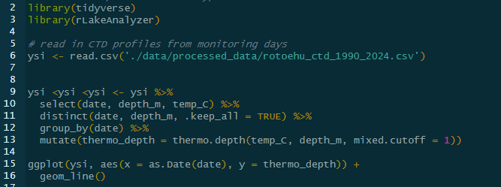
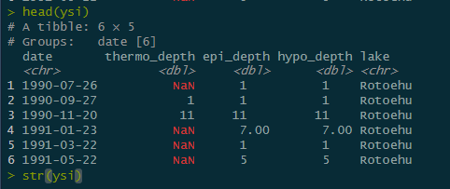
When to put (or keep) things in your script vs in the console
Script = things you want to rerun next time you open Rstudio
Console = things you just need to check for now and don’t need to reproduce later
Script
Console

Slide 23
Useful resources
Style guidelines in R
Blog on project-oriented workflows
ChatGPT and Google
Article on suggestions for how to best utilize ChatGPT
When first starting out, if you wouldn’t be able to explain what the code is doing, try not to use it—or ask someone to help you understand
ChatGPT will give you functions, for loops, etc. These are more advanced techniques that you will need to write yourself some day
Each other!

Slide 24
Let’s go to a working example
Link here to a Github repository: https://github.com/wwoelmer/R_Workshop_UoW_2024
Create a project using an existing directory (where you unzipped the folder)
Open the script “Lesson1_Fundamentals_of_R.R” in RStudio
Install some packages
Create new object in R
Read in a .csv and a .xls file
Look at help documentation for a function

Slide 25
Setting up a “Project” in R
Step 1: Open RStudio
Step 2: Select “New Project” in upper right in Rstudio

Slide 26
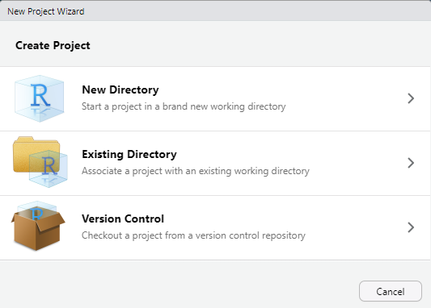
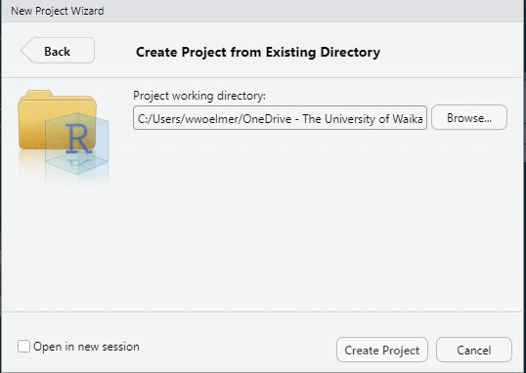
Setting up a “Project” in R
Step 1: Open RStudio
Step 2: Select “New Project” in upper right in Rstudio
Step 3: Select “Existing Directory” -> Navigate to where you unzipped the folder on your PC

Slide 27
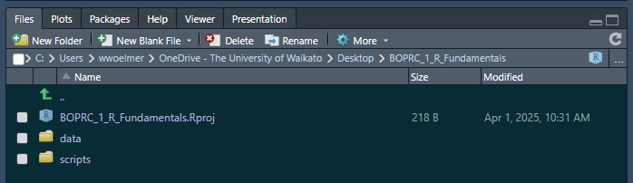
File structure in R should look like this (but on your computer)

Slide 28
Extra files for different lessons if needed

Slide 29
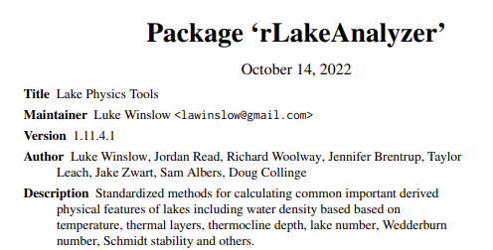

What is RLakeAnalyzer?
A set of tools for calculating common physical lake metrics in R (e.g., heatmaps, thermocline depth, Schmidt stability)
Part of GLEON (Global Lake Ecological Observatory Network) project that was led primarily by PhD students originally in 2011 and has been continuously updated
The code underlying the package and a couple examples can be found here: https://github.com/GLEON/rLakeAnalyzer
A description of functions here: https://cran.r-project.org/web/packages/rLakeAnalyzer/rLakeAnalyzer.pdf

Slide 30
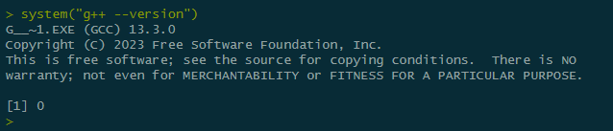
Installing Rtools
Rtools is needed for downloading packages which need compilationg (i.e., those that are not on CRAN, custom packages which someone has built)
Download Rtools from here: https://cran.r-project.org/bin/windows/Rtools/rtools44/rtools.html
Then run
system("g++ --version")
In rstudio. If you get a single number (127) that means Rtools is not properly installed. If you get an output like that below, it worked!

